Slide 1
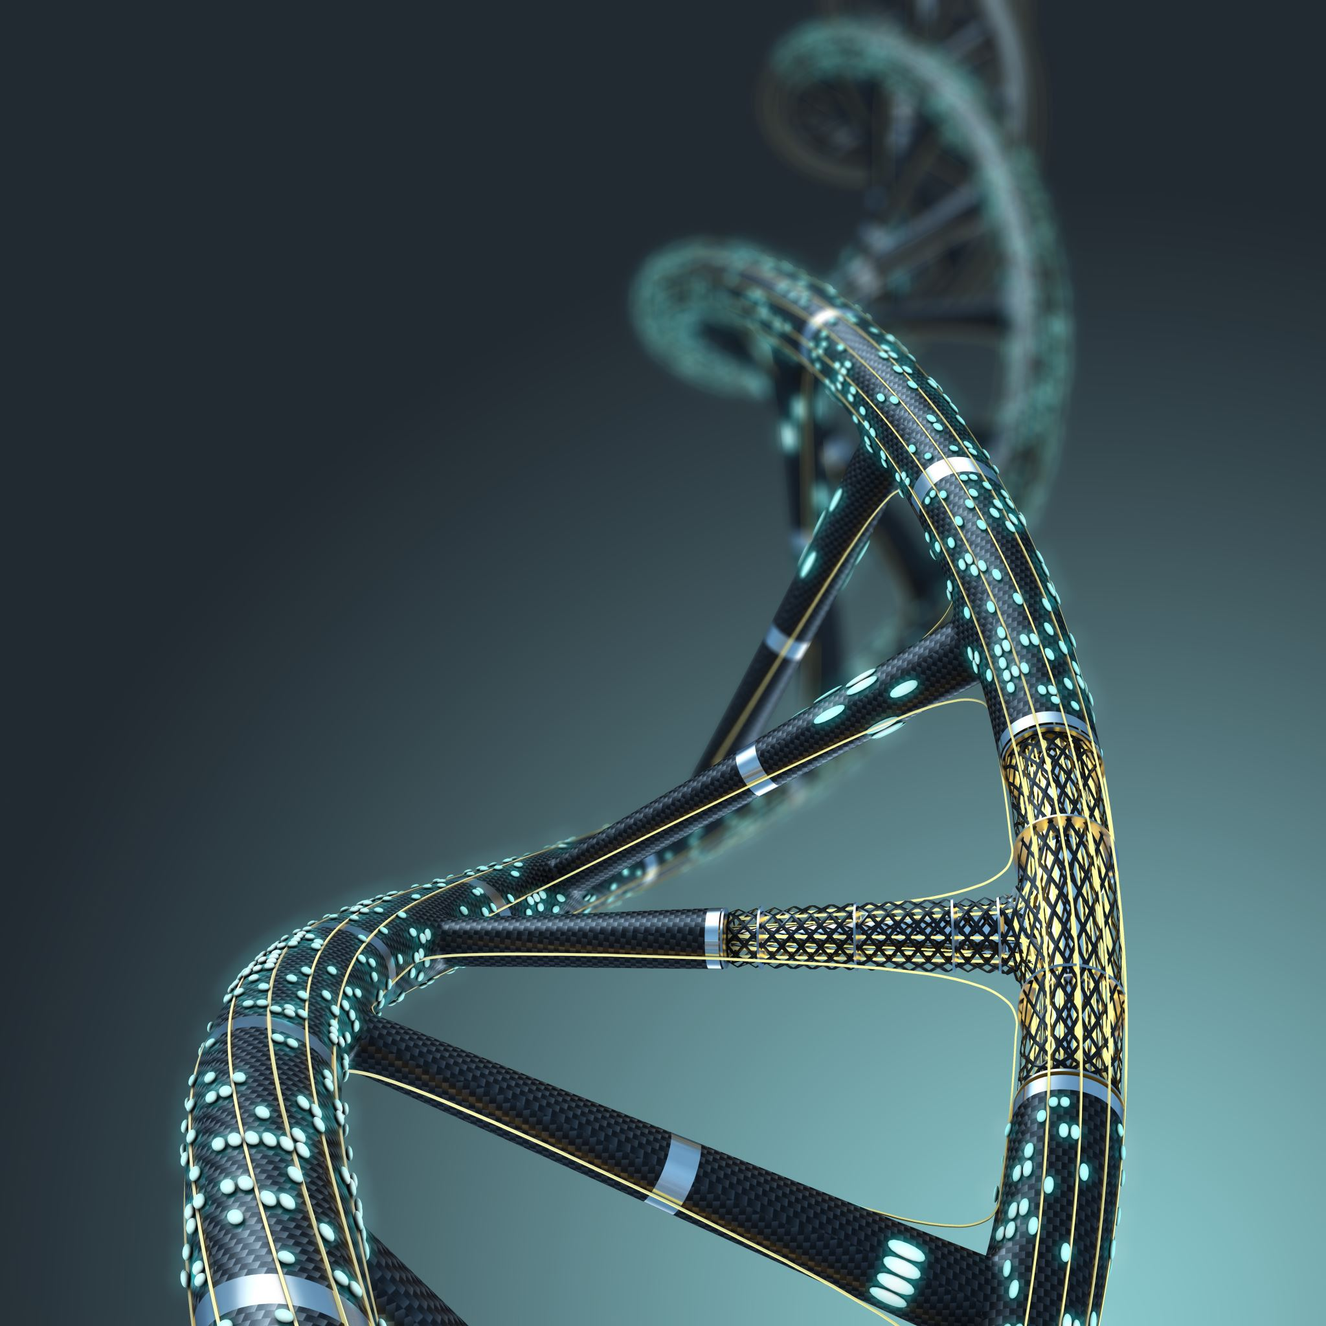

Illumina paired-end dna sequencer SIMULATOR
Ana Vanzo 2021/3355

Slide 2

Illumina sequencing
Shearing (fragmentation of the genome)
Attaching adapters
PCR amplification (optional)
Attaching template to surface/flowcel
PCR/bridge amplification (cluster creation)
Adding fluorescent bases and taking a picture after each cycle (repeat this many times)
Stack up images and read the sequence

Slide 3
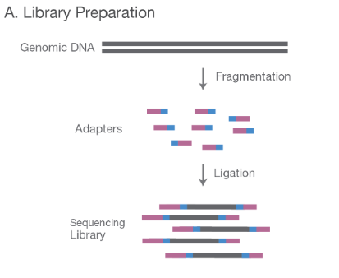
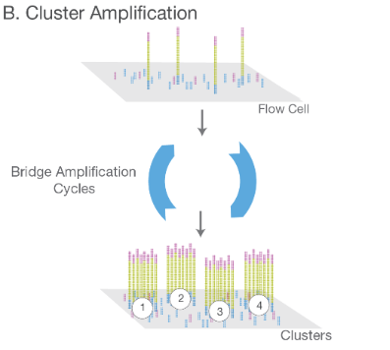
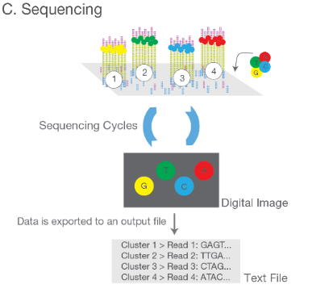
Illumina sequencing

Slide 4
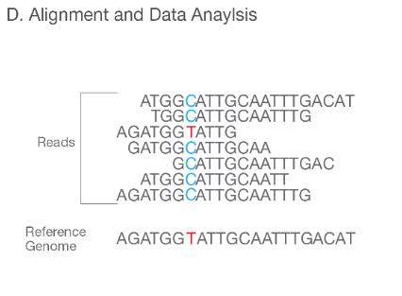

Alignment and data analysis

Slide 5
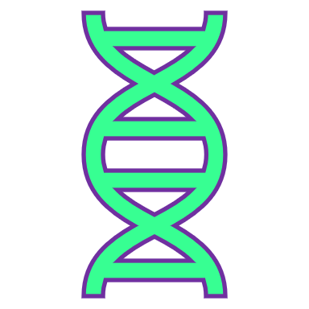
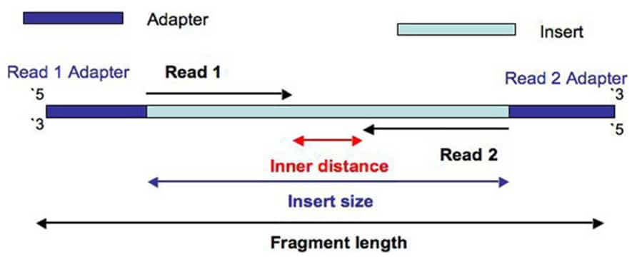
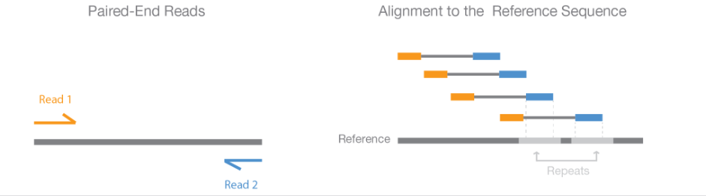

Paired-end sequencing and alignment

Slide 6
Illumina paired-end Sequencing simulation
FASTA file parsing
Genome sequence fragmentation
Paired-end reads creation
Adding sequencing errors
Writing paired reads to FASTQ file
Creating alignments/writing to SAM file

Slide 7
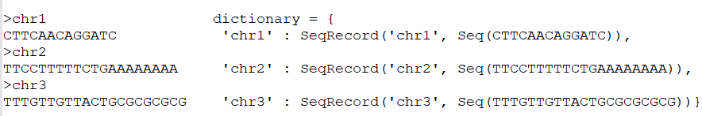
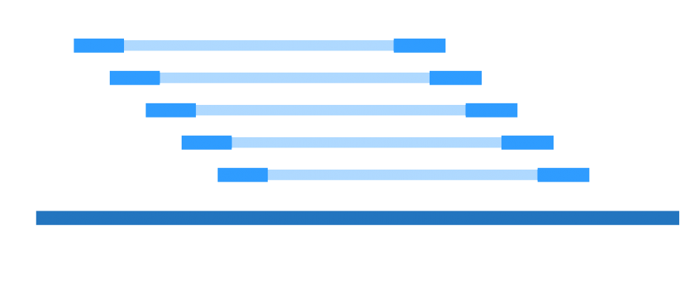
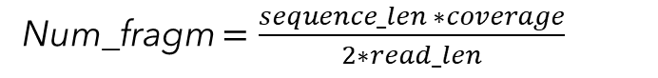
Illumina paired-end Sequencing simulation
1. FASTA file parsing
Num_fragm $=\frac{sequence_len ∗coverage}{2∗read_len}$
2. Genome sequence fragmentation

Slide 8
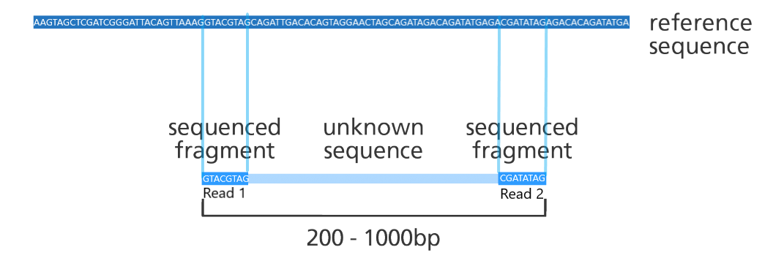
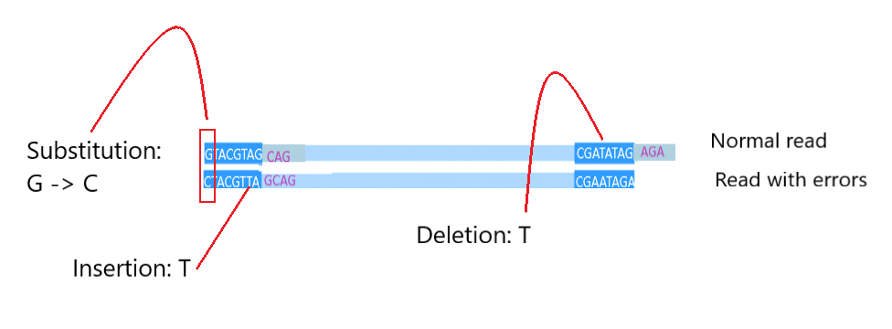
Illumina paired-end Sequencing simulation
3. Paired-end reads creation
4. Adding sequencing errors

Slide 9
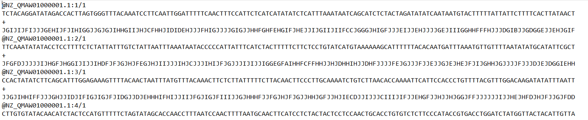
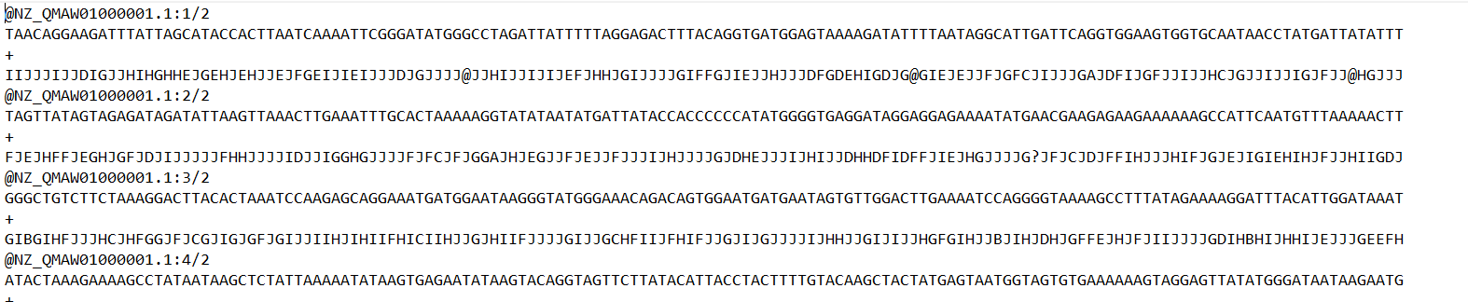
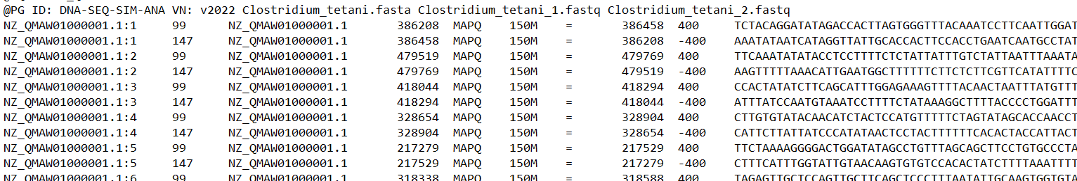
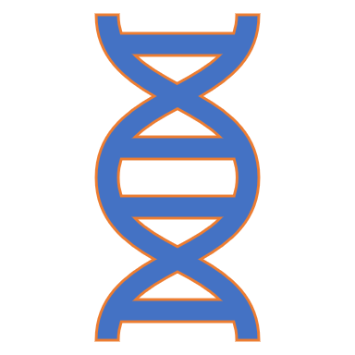
Read_1.fastq
Read_2.fastq
Read id
Sequence of bases
Base qualities (ASCII, Phred + 33)
Mate’s mapping position
Mapping position
Cigar string
Alignments.sam
Flag
6. Writing to FASTQ and SAM files

Slide 10



WORKFLOW
Simulator (sequencing mode)
Insert size
Read length
Coverage
Average quality
SNV rate
Insertion rate
Deletion rate
Out SAM directory
Out FASTQ directory
Reference genome(FASTA)
SAM file
BWA MEM SAM
BOWTIE SAM
Simulator (comparing mode)
FASTQ files
SAM file
BWA MEM Bundle 0.7.17 on CGC
BWA MEM
Bowtie2
Bowtie2 on CGC
BWA MEM SAM
BOWTIE SAM

Slide 11
COMPARISON RESULTS
Test genomes
Human herpesvirus
151 KB
Clostridium tetani
2.79 MB
Mycobacterium tuberculosis
4.25 MB
Error rates
 | SNV | INS | DEL
Set 1 | 0 | 0 | 0
Set 2 | 0.0003 | 0.0003 | 0.0003
Set 3 | 0.03 | 0 | 0
Set 4 | 0 | 0.03 | 0.03
Set 5 | 0.03 | 0.03 | 0.03
Coverage | 3
Avg quality | 40
Insert size | 400
Read length | 150

Slide 12
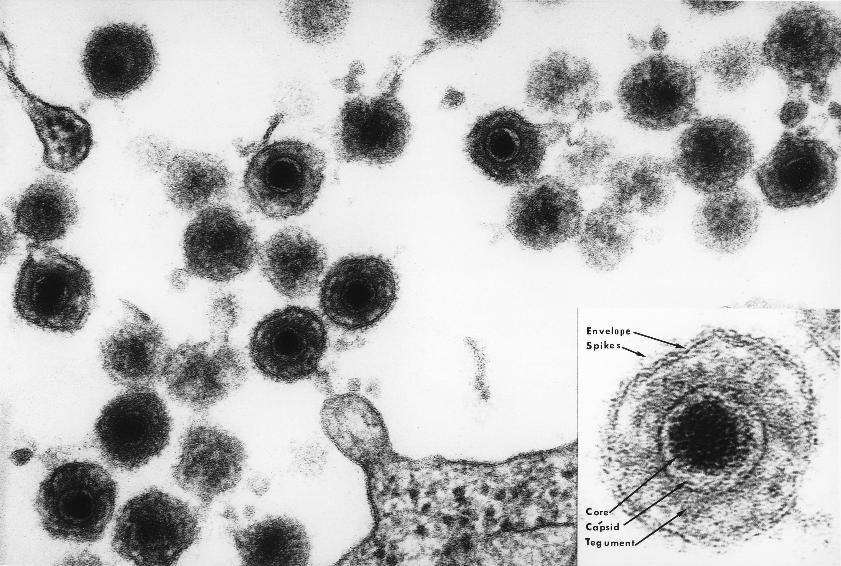
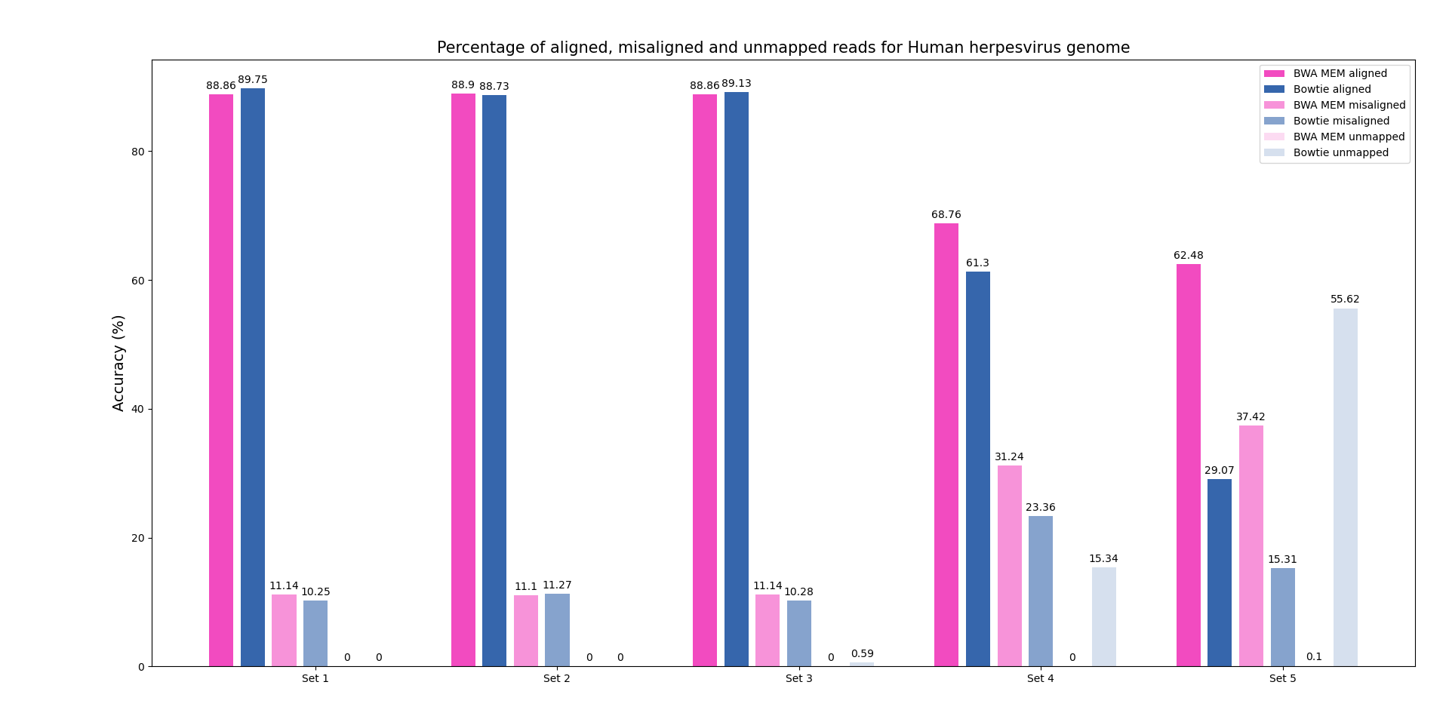
Human herpesvirus

Slide 13
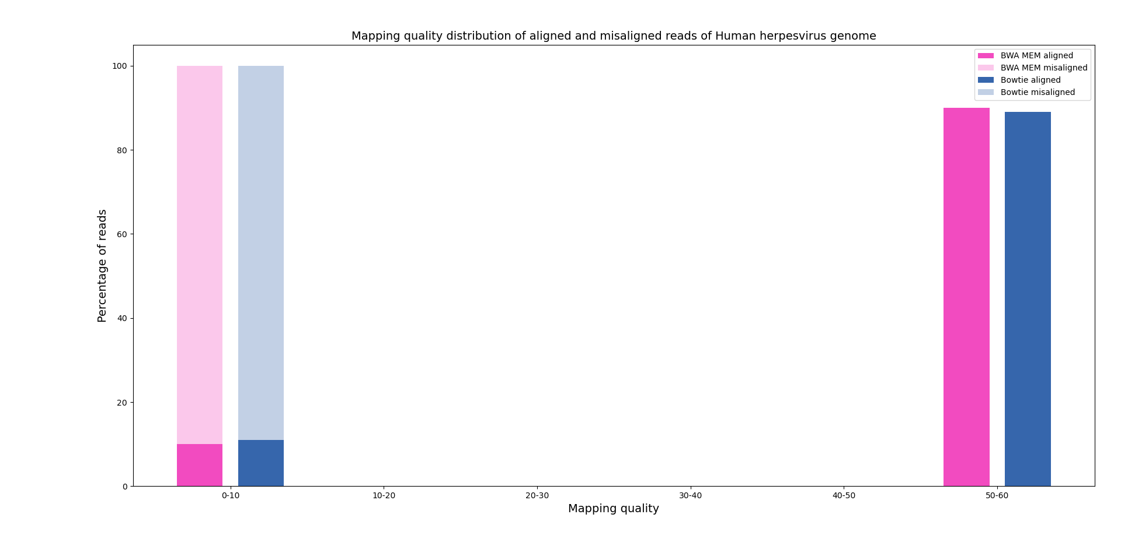
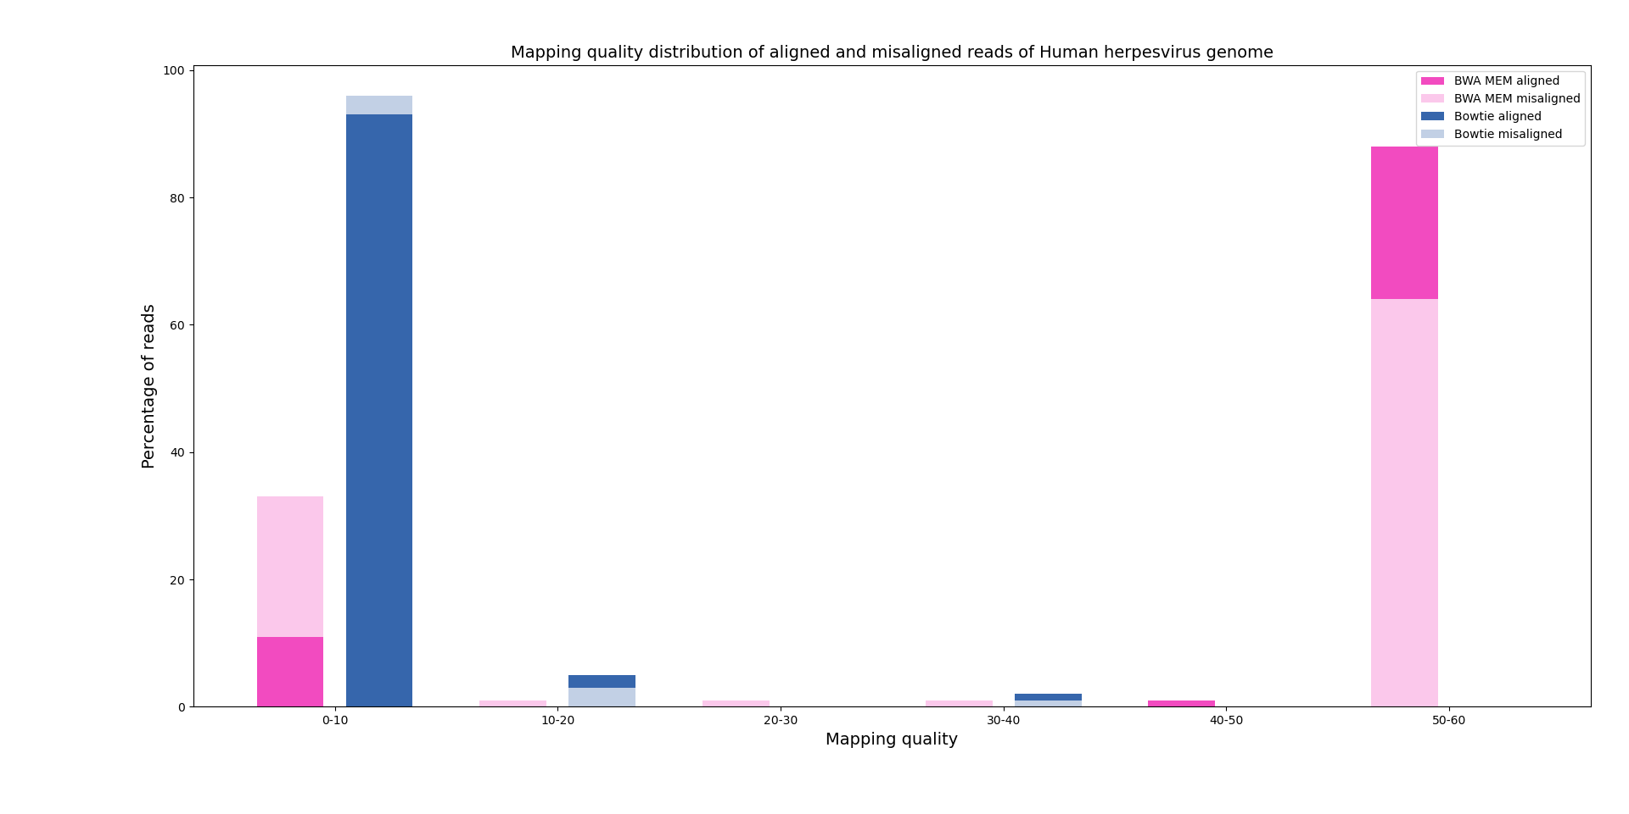
Mapping quality distribution for set 1
Mapping quality distribution for set 5

Slide 14
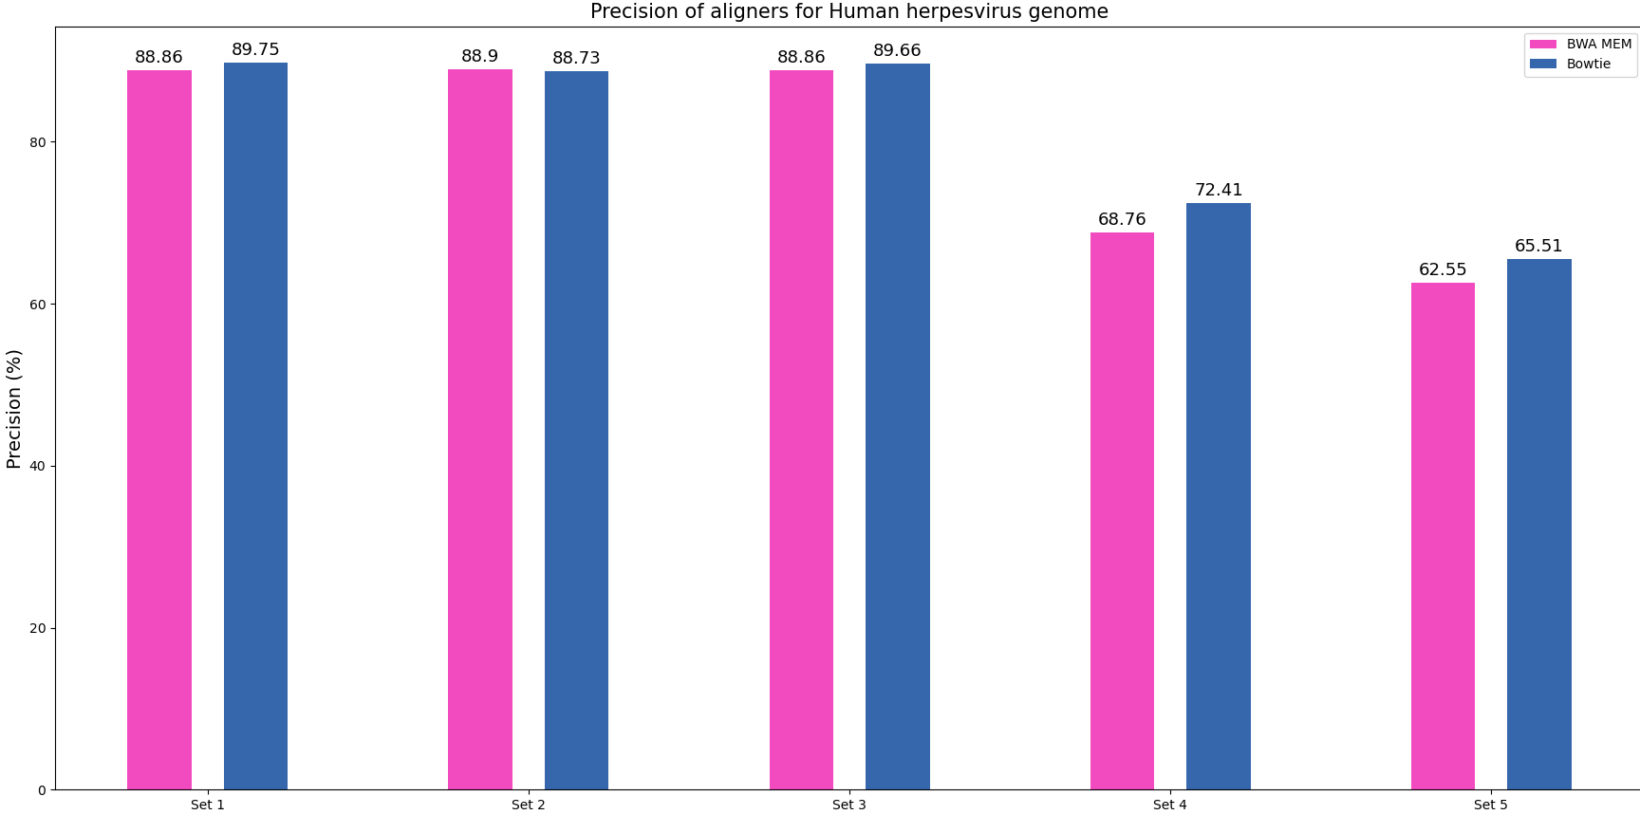
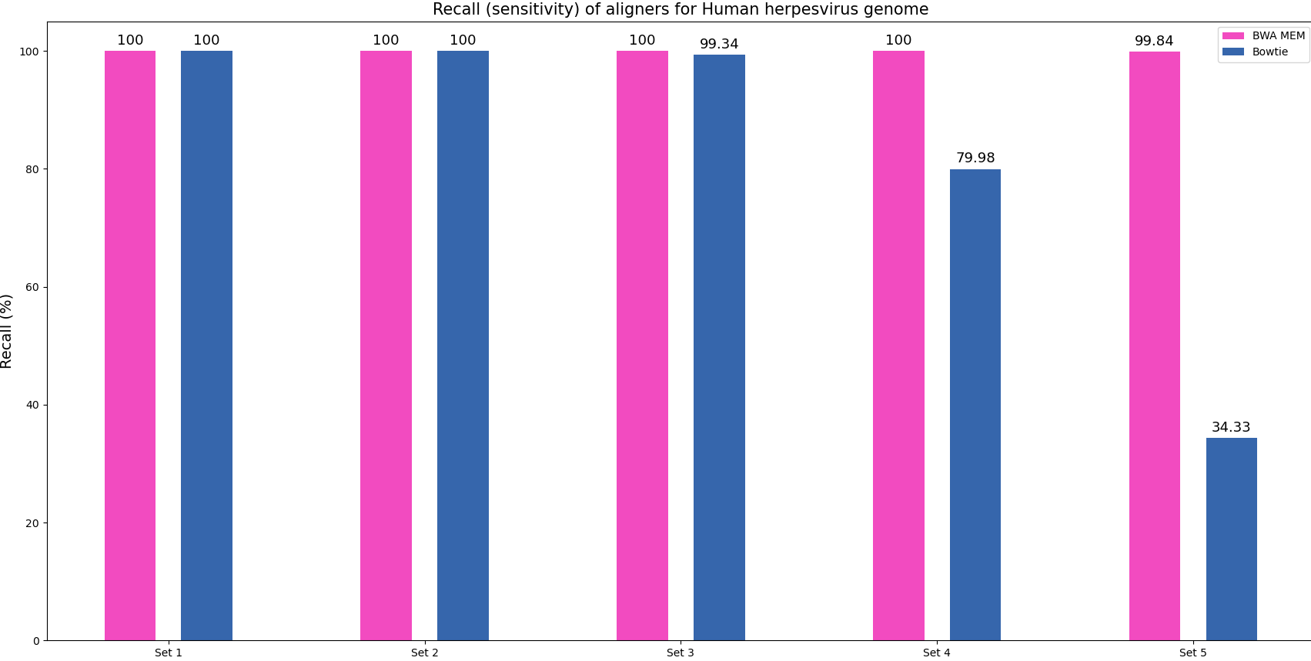
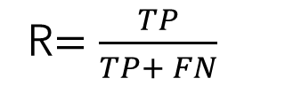
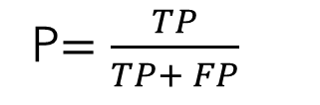
P$=\frac{TP}{TP+ FP}$
Correctly aligned reads
R$=\frac{TP}{TP+ FN}$
Correctly aligned reads
Misaligned reads
Unmapped reads

Slide 15
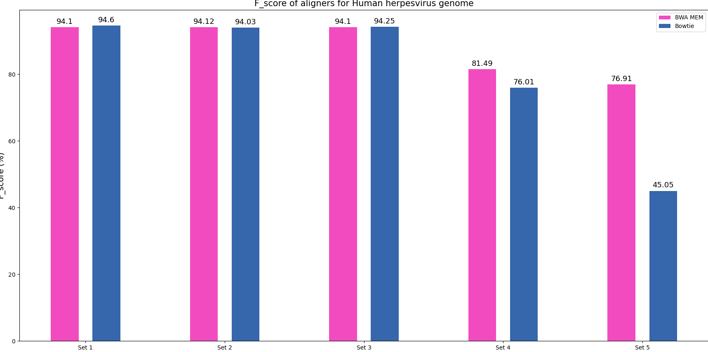
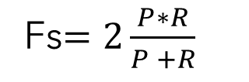
Fs$=2\frac{P∗R}{P +R}$

Slide 16
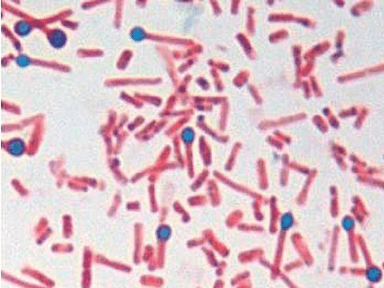
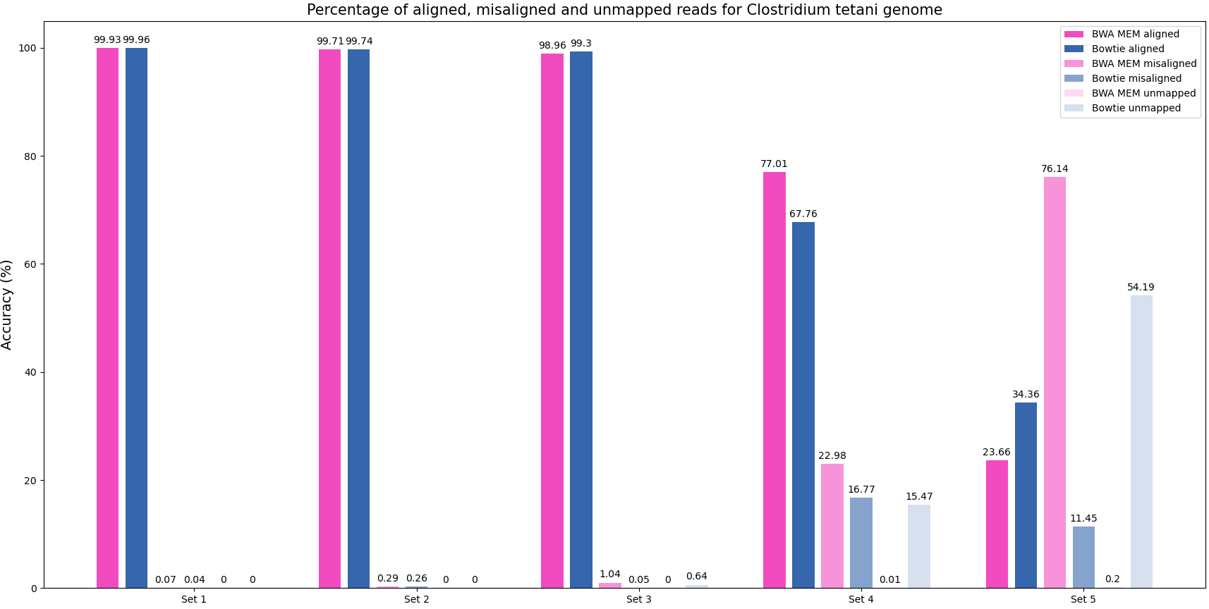
Clostridium tetani

Slide 17
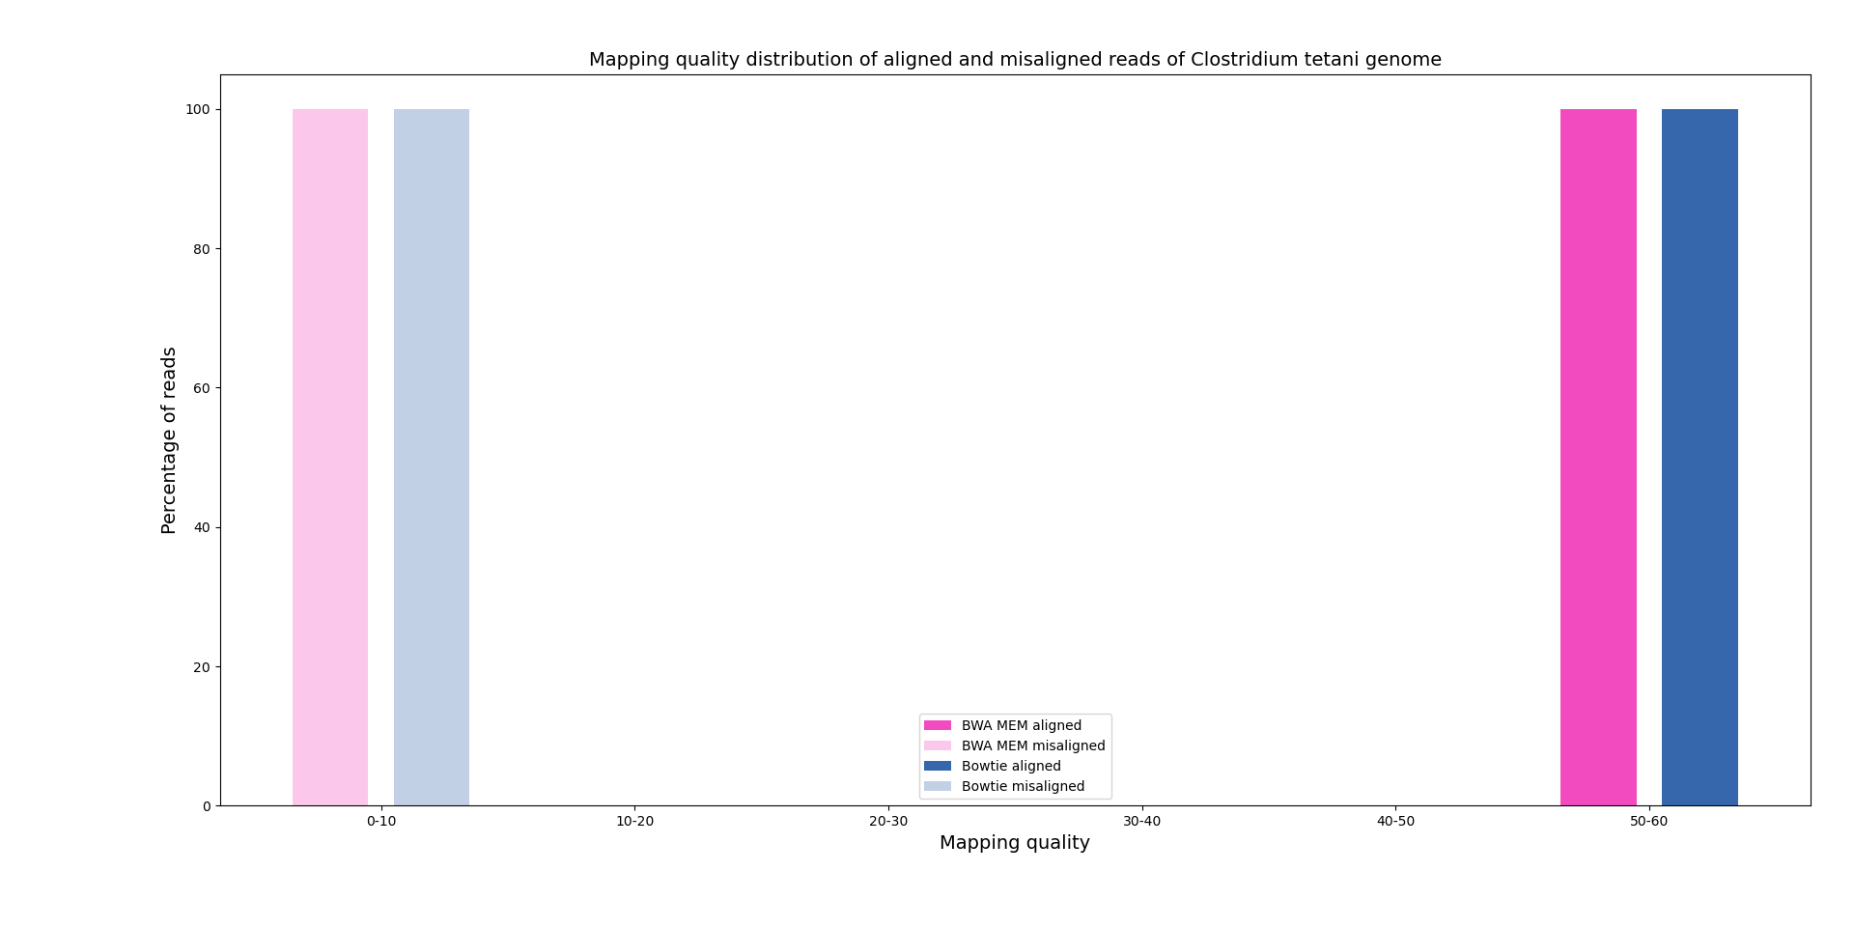
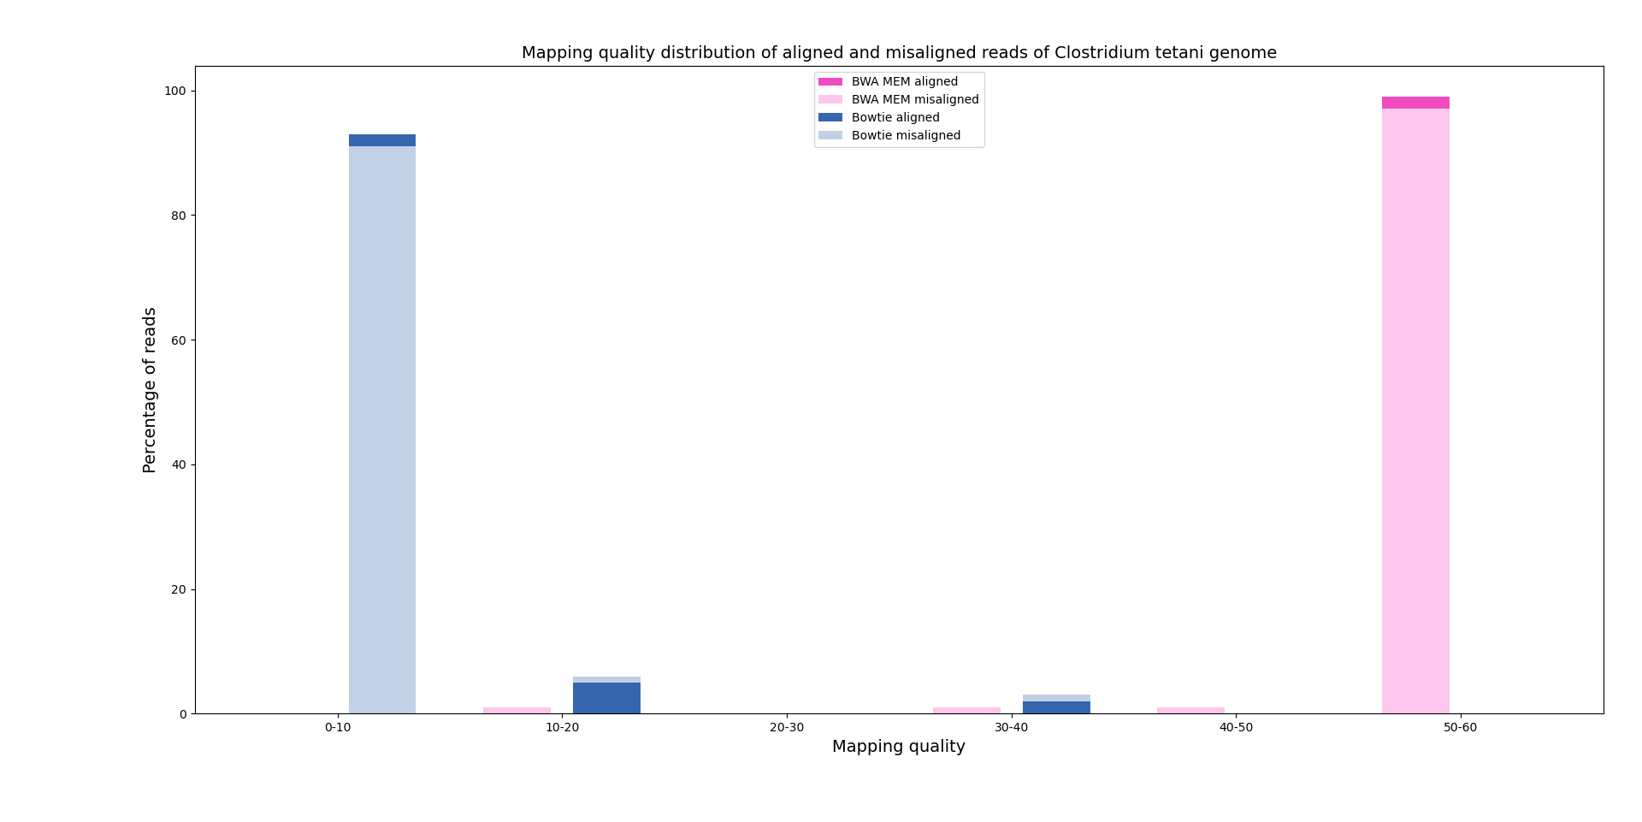
Mapping quality distribution for set 1
Mapping quality distribution for set 5

Slide 18
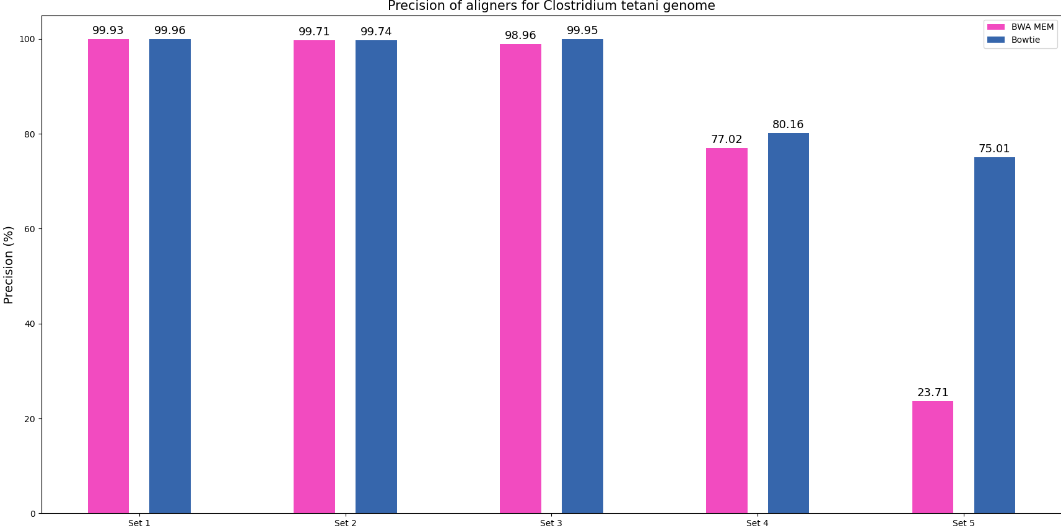
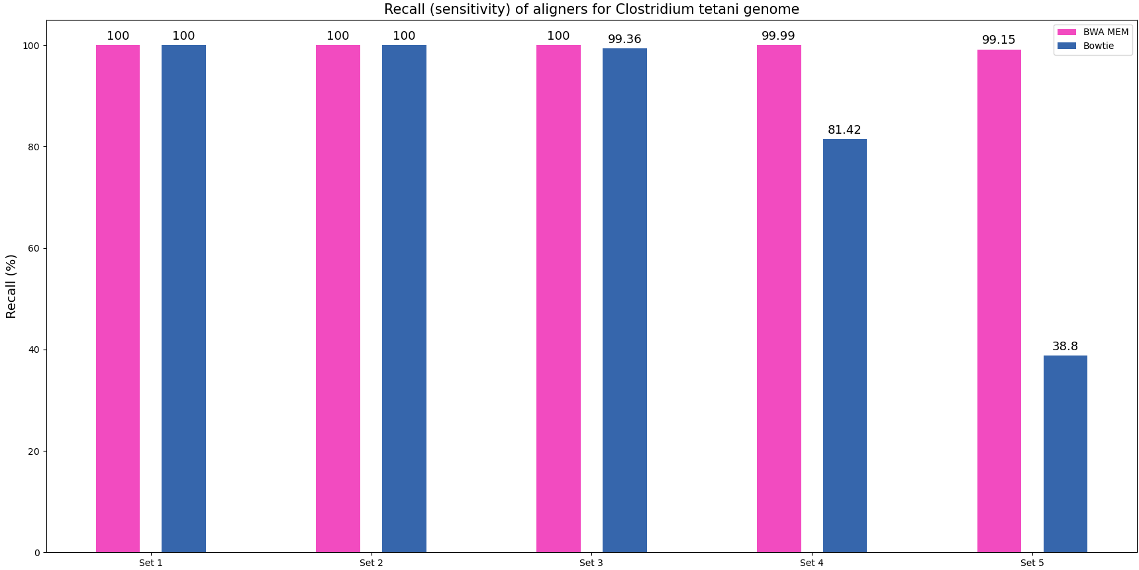
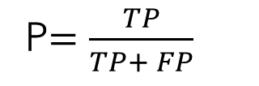
Correctly aligned reads
R$=\frac{TP}{TP+ FN}$
Correctly aligned reads
P$=\frac{TP}{TP+ FP}$
Misaligned reads
Unmapped reads

Slide 19
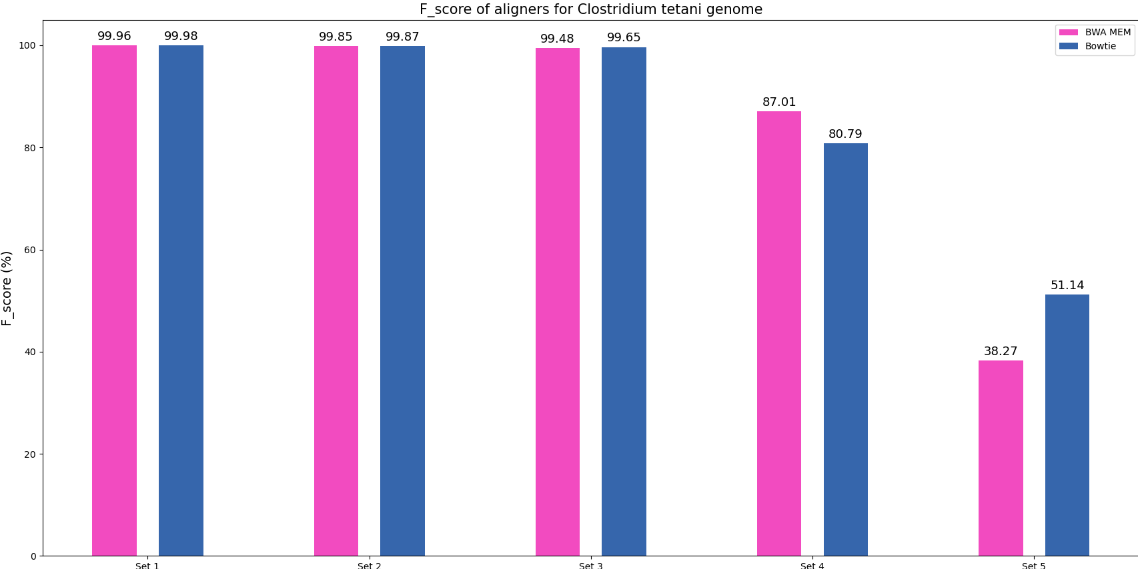
Fs$=2\frac{P∗R}{P +R}$

Slide 20
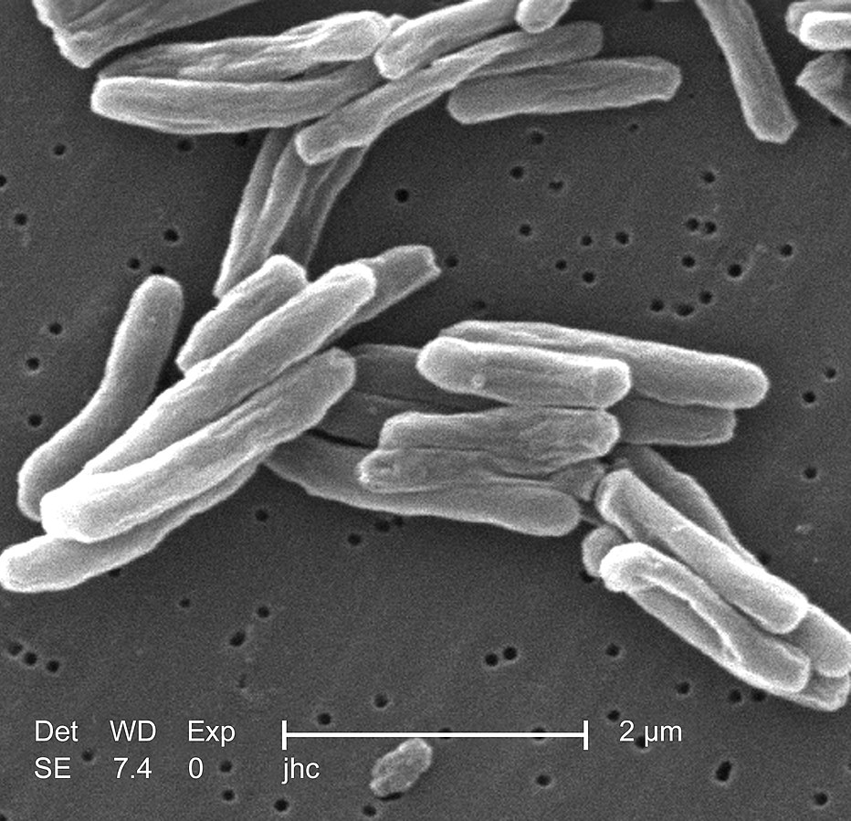
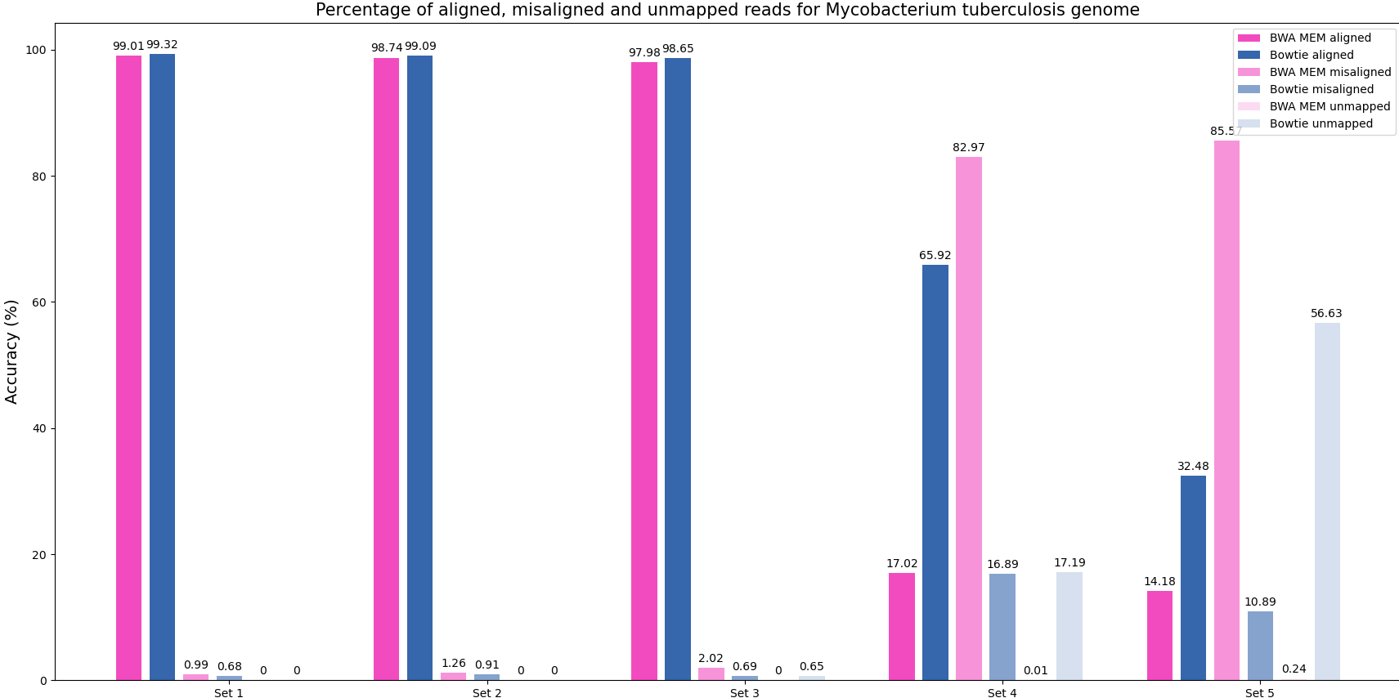
Mycobacterium tetani

Slide 21
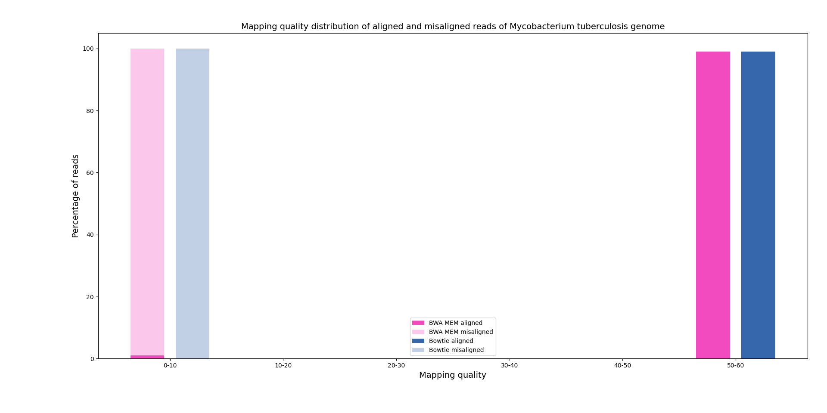
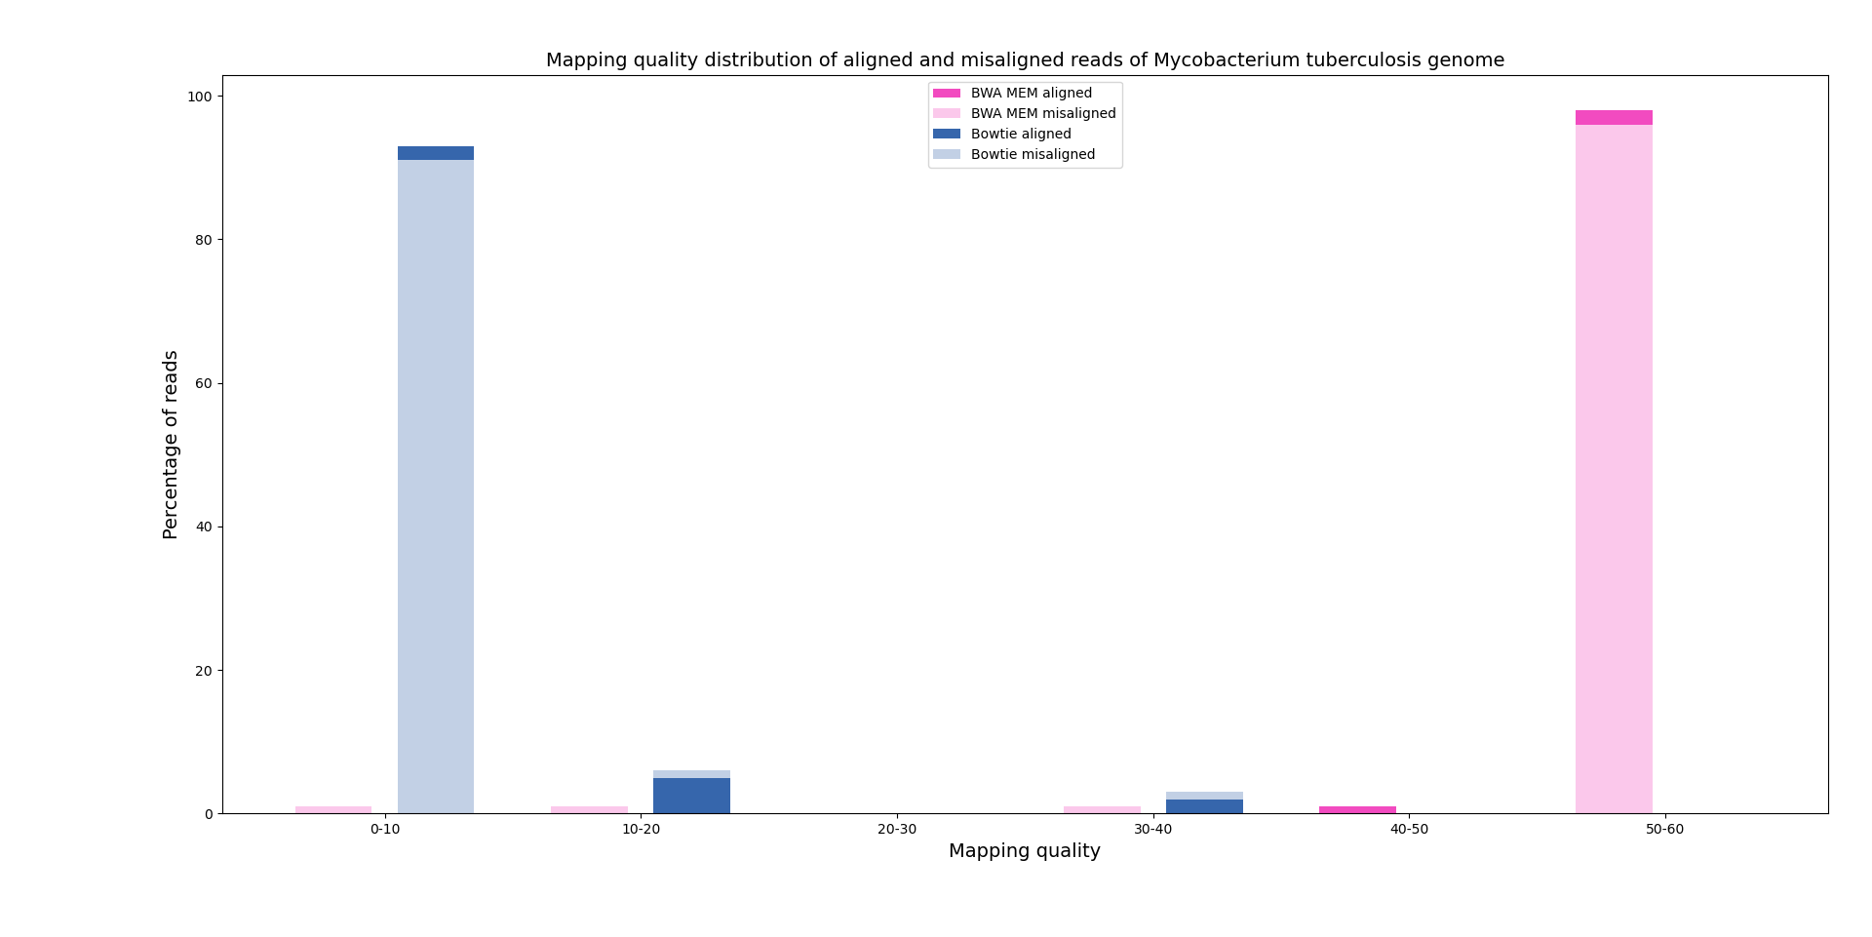
Mapping quality distribution for set 1
Mapping quality distribution for set 5

Slide 22
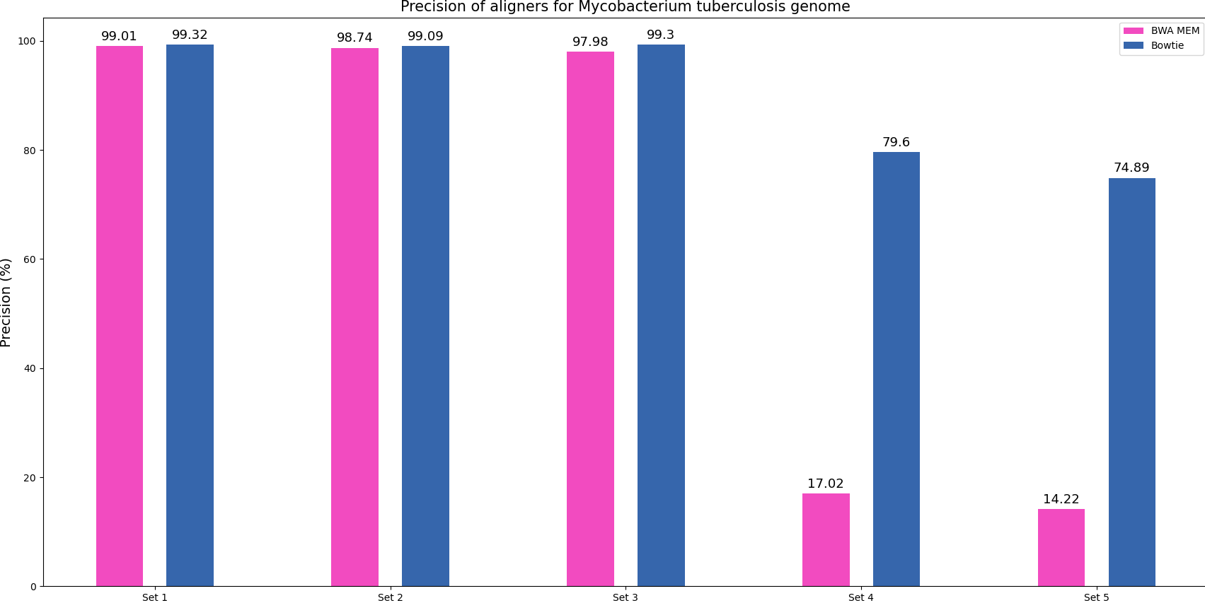
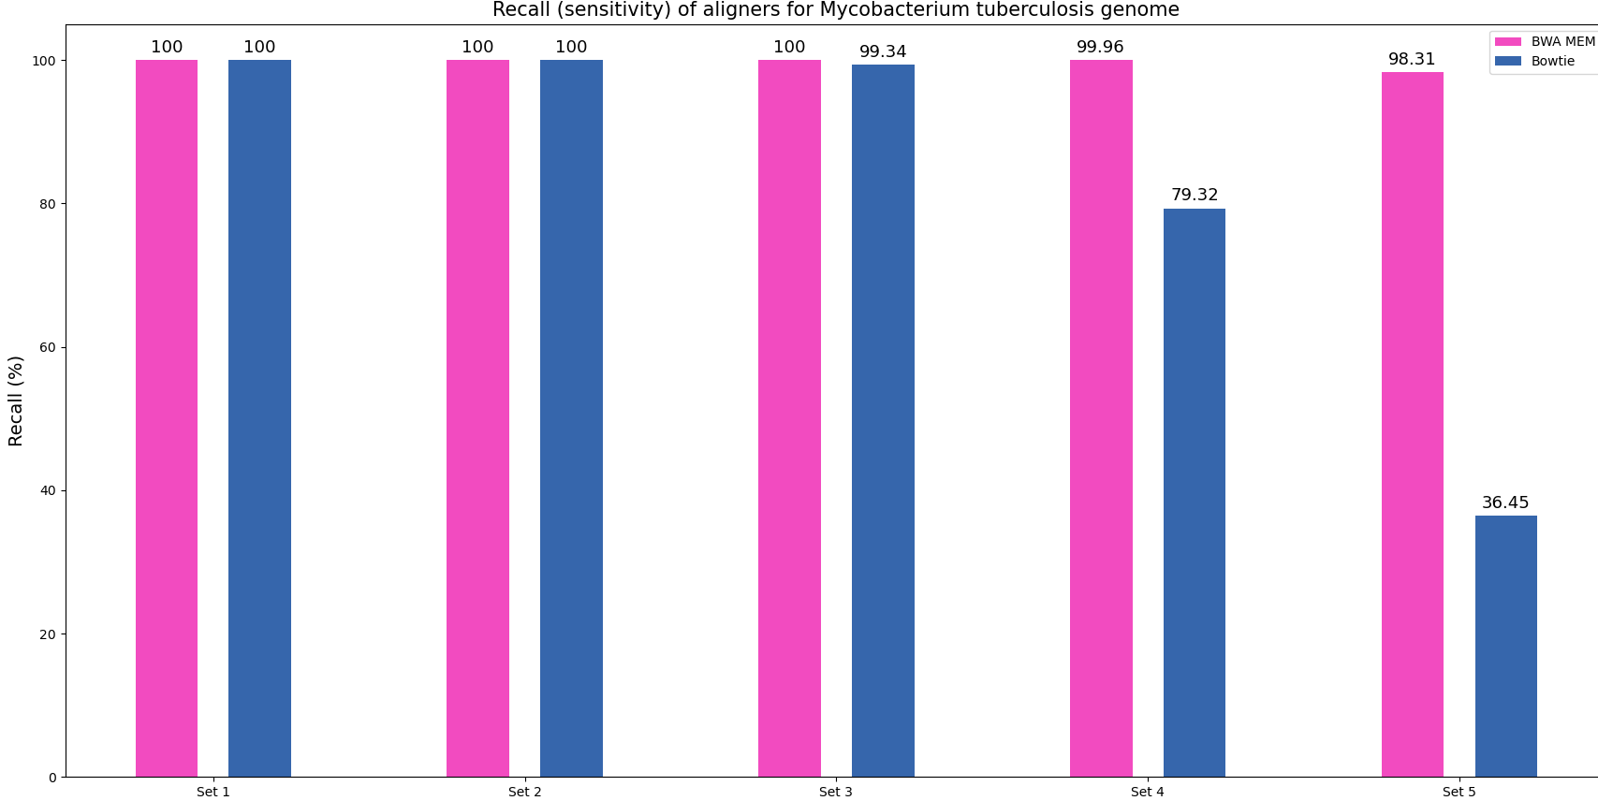
P$=\frac{TP}{TP+ FP}$
Correctly aligned reads
R$=\frac{TP}{TP+ FN}$
Correctly aligned reads
Misaligned reads
Unmapped reads

Slide 23
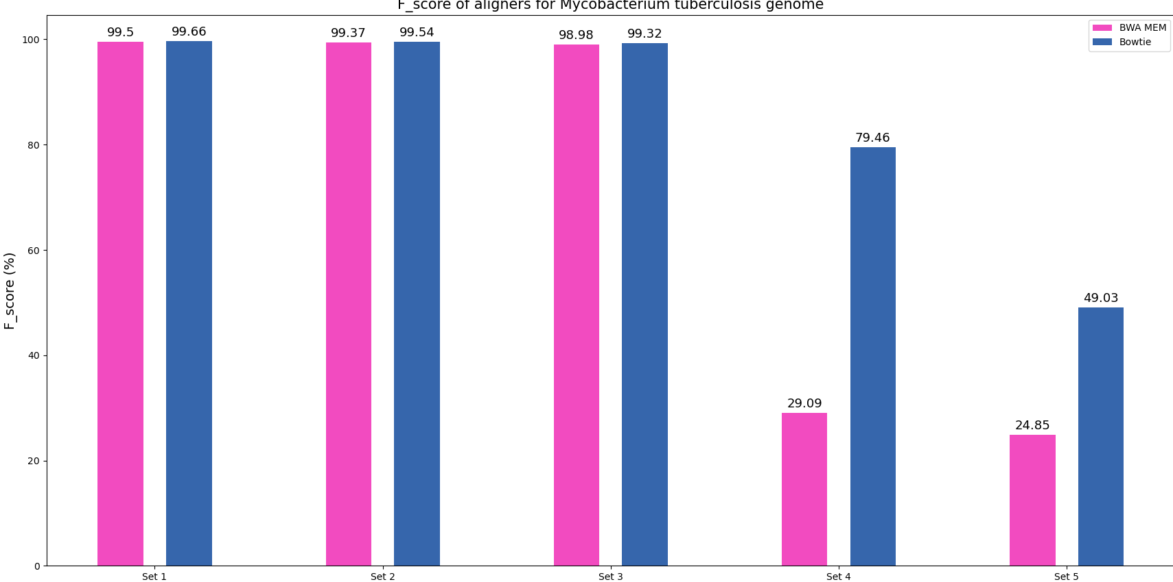
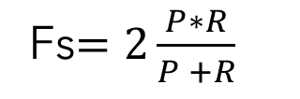
Fs$=2\frac{P∗R}{P +R}$

Slide 24
DISCUSION
In sets with low or non-existent error rates, both BWA MEM and Bowtie showed relatively similar accuracy, precision, recall and fscore % (Bowtie scored higher for ~1%) for all 3 test genomes.
In sets with medium error rates for genomes 1 and 2, BWA MEM came out as more tolerant to error rates than Bowtie in terms of accuracy (ratio of correctly aligned reads and all reads), but also scored higher in misaligned reads %, whereas Bowtie’s misaligned reads % stayed much lower than BWA MEM’s through all 5 sets (even in sets with high error rates), but unmapped reads % increased propotionally to the error rates. In genome 3 (Mycobacterium tuberculosis) Bowtie outperformed BWA MEM in all 5 sets in accuracy.
In set with highest error rates, for largest test genome (> 4MB), Bowtie surpassed BWA MEM in correctly aligned reads %, precision and fscore. For smaller test genome like Human Herpesvirus (~150KB), BWA MEM scored higher in accuracy in sets with significant error rates.
In terms of precision, Bowtie scored higher in all 5 sets of errors (for all 3 test genomes), while BWA MEM scored higher in recall through all 5 sets of errors and 3 test genomes.
Mapping quality distribution in sets with low error rates showed that both Bowtie and BWA MEM are good in differentiating misaligned from correctly aligned reads by assigning lower MAPQs to misaligned reads, and higher MAPQs to correctly aligned reads. In sets with higher error rates BWA MEM tends to assign higher MAPQ even to misaligned reads, while Bowtie assigns lower MAPQ even to correctly mapped reads.
Wrongly mapped reads also classified as false positives can later lead to false positives variant calls. Unmapped reads are false negatives since tools haven’t aligned them at all, nor correctly nor wrongly. Unmapped reads are not as critical as misaligned since they are easily filtered out and don't bring confusion in later stages of DNA analysis.

Slide 25
THANK YOU

